Slide 1
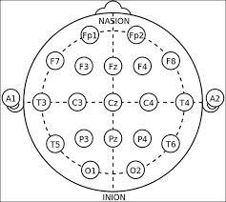
MI EEG signal
Motor imagery is a mental process by which an individual rehearses or simulates a given action. An EEG signal is produced in this action.

Slide 2
Task Overview
CLASSIFICATION of a two class MOTOR IMAGERY BASED EEG DATA
CLASSIFICATION PROCEDURES were studied, implemented and compared in order to find a procedure to suite the particular data type
The ALGORITHMS WERE TESTED
1. On a standard dataset
2. On Experimental data collected using “Emotiv”.

Slide 3
Overview of a classification procedure
Data Pre-processing
Feature extraction
Classification using different algorithms
10-fold cross validation
Classification outcomes
EEG signals
of two
classes
Each of the 118 columns had data from both the classes. This is because of the experimental setup
Each of the 118 columns had data from both the classes. This is because of the experimental setup
Each of the 118 columns had data from both the classes. This is because of the experimental setup
Each of the 118 columns had data from both the classes. This is because of the experimental setup
Each of the 118 columns had data from both the classes. This is because of the experimental setup
Each of the 118 columns had data from both the classes. This is because of the experimental setup
Each of the 118 columns had data from both the classes. This is because of the experimental setup
Each of the 118 columns had data from both the classes. This is because of the experimental setup
Each of the 118 columns had data from both the classes. This is because of the experimental setup
Each of the 118 columns had data from both the classes. This is because of the experimental setup
Each of the 118 columns had data from both the classes. This is because of the experimental setup
Each of the 118 columns had data from both the classes. This is because of the experimental setup

Slide 4


Data format and Processing
Input data Format Matrix of 118 columns where each column represent a signal obtained from a particular channel
Each of the 118 columns had data from both the classes. This is because of the experimental setup
118

Slide 5


Data format and Processing
The matrix of 118 columns each columns have been represented in two classes.
In machine learning terms there are 118 training examples or samples for each class
118
class1
class1
class2
118
class1
class2

Slide 6
Techniques used for feature extraction
Cross Correlation
Discrete Wavelet Transform
Cross Correlation
+
Discrete Wavelet Transform

Slide 7
Cross-correlation
One reference signal
EEG signals of two classes
Cross correlation
Cross-correlograms
Statistical feature extraction
All the non-reference signals

Slide 8
Cross-correlation
118
118
235
Max
The reference signal (C3 and Fp1) of a class is cross correlated with the data of the remaining signals of this class and the data of all signals of another class.
235 Feature vector of six dimension is obtained for classification
Min
Mean
Mode
Reference signal
Median
S.D.

Slide 9
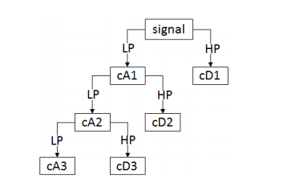
DWT
Daubechies-4 (db4) decomposition filter
Nine features are to be extracted from these coefficients.
The first three are variances of the detail coefficients at level 1, 2 and 3.
Detail coefficients at level 4, 5 and 6 have been auto correlated. Variance of them was then calculated to give the next three features.
The last three features were found by taking the absolute mean of smoothened versions of detail coefficients at level 1, 2 and 3

Slide 10
Techniques used for classification
LS-SVM
LR
KLR
MLP
PNN

Slide 11


Data Acquisition Using Emotiv and Classification
An experimental cue was set up in which for first 20 secs the person had to imagine a particular task say right hand movement. This was followed by a 5 sec delay and then for next 20 secs subject had to imagine another task say right leg movement.
Data Acquisition using Emotive

Slide 12
Results

Slide 13
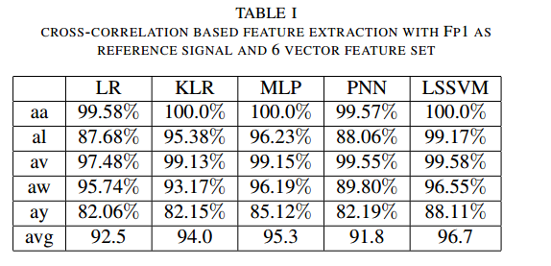
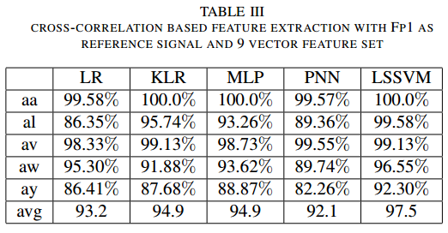
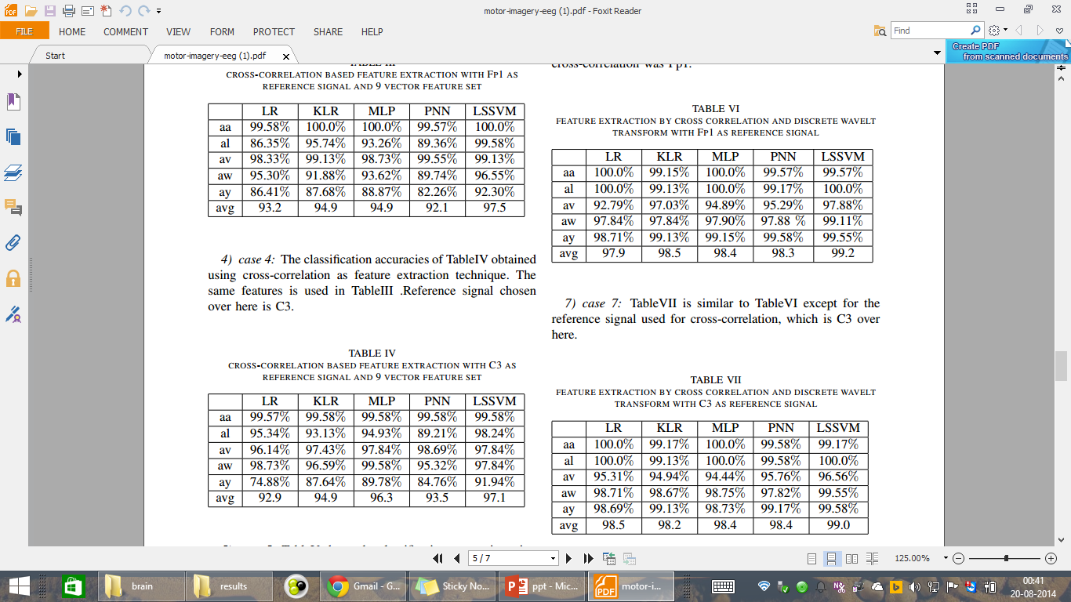
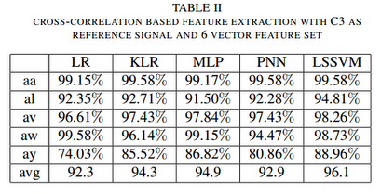

Slide 14
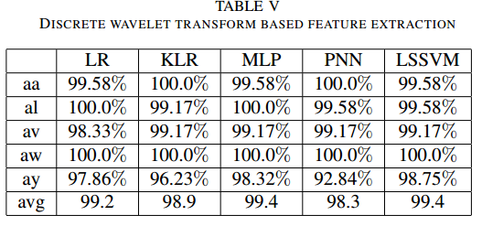

Slide 15
Classification by LS-SVM
Least Square-SVM is employed with radial basis function (RBF) kernel as a classifier to distinguish the features obtained from the cross-correlation technique[23-25].
The obtained training feature vector of six dimensions are used as the input to train the LS-SVM classifier and the testing feature vector sets are employed to verify the performance and the effectiveness of the trained LS-SVM for the classification of two-class of EEG signals in the both datasets.
Gamma and sigma is regularized parameter have been chosen gamma is 500 sigma is 20 for best accuracy
LS-SVMlab Toolbox (Available: http://www.esat.kuleuven.ac.be/sista/lssvmlab/

Slide 16
Classification using LS-SVM…..
These two important parameters of the LS-SVM are selected by a two-step grid search technique for getting reliable performance of the method[17-19].
Classification using LS-SVM technique is employed using the standard function present in the LS-SVM toolbox
The classification performance is measured using the 10 fold cross validation technique
J. A. K. Suykens et.al , Least Square Support Vector Machine. Singapore: World Scientific, 2002

Slide 17
Logistic Regression(LR)
To compare the performance of the proposed LS-SVM classifier, we employ the logistic regression classifier for the same feature sets.
The parameters of LR are estimated by maximum likelihood estimation (MLE)
Where yn is its class label and feature vector xi = [x1 x2…xn]^{T}
LR technique is employed using “glmfit” and “glmval” functions present in matlab.
The classification accuracy is measured using the 10 fold cross validation technique.

Slide 18
Kernelised Logistic Regression…..
Kernel logistic regression is a nonlinear form of logistic regression. It can be achieved via the so-called “kernel trick” which has the ability to classify data with nonlinear boundaries and also can accommodate data with very high dimensions[24].
The parameters of this method are automatically estimated by iteratively re-weighted least square procedure
The performance of the algorithm is evaluated through a 10-fold cross-validation procedure.
http://www.di.ens.fr/~mschmidt/Software/code.html

Slide 19
Cross-Validation
10-fold cross-validation method is used for assessing the performance of classifier. This procedure divides the feature vector sets into ten approximately equal-sized distinct partitions.
One partition is then used for testing, while other partitions are used for training the model.
To further improve the estimate, the procedure is repeated ten times and all accuracies over these ten runs are averaged.
The average accuracy over the ten runs obtained from the test data is taken as the performance evaluation criteria in this study

Slide 20
Additional
Different feature extraction techniques were tried in order to improve the accuracy
DWT gives better results even over all the subjects.
Tried combinations of Cross- correlation and DWT but DWT alone is seemed better for extract features
Two additional algorithms have been tested which are MLP (multi layer perceptron) and PNN (probabilistic neural network ) on same data set using MATLAB toolbox.
The number of hidden layers could be varied and different number of hidden layer yielded different accuracies. The number of hidden layers have been chosen so as to maximise the accuracy.

Slide 21
For PNN, Training and testing have been done using the Neural Network toolbox present in MATLAB. RBF was used as a kernel function.
Different kernel parameters resulted in different accuracies, hence a range from 0.05 to 0.5 was considered and that value was chosen which resulted in maximum accuracy.

Slide 22
Results and Discussion
Classification using Cross-Correlation for Feature Extraction:
C3 as Reference signal
Fp1 as Reference Signal
Sub | LR | KLR | LSSVM
aa | 99.15 | 99.58 | 99.58
al | 92.35 | 92.71 | 94.81
av | 96.61 | 97.43 | 98.26
aw | 99.58 | 96.15 | 98.73
ay | 74.03 | 85.52 | 88.96
avg | 92.3 | 94.3 | 96.1
Sub | LR | KLR | LSSVM
aa | 99.58 | 100 | 100
al | 87.35 | 95.38 | 99.17
av | 97.61 | 99.13 | 98.26
aw | 95.74 | 93.15 | 96.55
ay | 82.03 | 82.15 | 88.11
avg | 92.5 | 94.0 | 96.7
Table7: Classification Accuracies using Cross- Correlated feature vector

Slide 23
Results and Discussion…….
Classification using DWT as Feature Extraction
Sub | LR | KLR | LSSVM
aa | 99.58 | 100 | 99.58
al | 100 | 99.71 | 99.58
av | 98.33 | 99.17 | 99.26
aw | 100 | 100 | 100
ay | 97.86 | 96.23 | 98.75
avg | 99.2 | 98.9 | 99.4

Slide 24
Results and Discussion…………..
LSSVM algorithm has given very fine results when compared to all the other algorithms.
DWT is giving distinctively better results for EEG signal classification.
Cross-correlation is giving good results but may not be preferred as it may cause the EEG signal to lose its temporal information.

Slide 25
Three trail has been done for each Subject. The data was then passed to a band pass filter(4Hz-40Hz) an processed according in the similar way as was done using standard datasets.
The number of columns in the data are 14 corresponding to each channel. Now channel number 2, 7, 8, 9, 10, 15 are deliberately removed from the data because of excessive noise content and non-MI information present in these channels. Hence the number columns which are left are 8.
Each column corresponds to a separate training example. Since there are only 8 columns, there are very less number of training examples to classify. This problem can be tackled by dividing the continuous time series of each channel into 12 sub datasets. Each of the 12 subsets of a particular channel can be used as a training examples.
There are 12 subsets for each channel and 8 channel in total, this amounts to 12*8=96 training examples. Also there are two classes which results in a total of 96*2=192 columns of training examples.

Slide 26
This method of dividing the dataset into subdata sets is used to improve the standard deviation of classification accuracies in a 10 fold cross-validation technique.
DWT is used for Feature extraction and the number of decomposition levels are chosen to be 4 and one final approximation. Wavelet coefficient is computed using db4.

Slide 27
Results
Classification Algorithm: Logistic Regression, Kernelized Logistic Regression ,Probabilistic Neural network.
Subject | LR | KLR | PNN
S1 | 56.5 ± 5 | 55.3± 4 | 52.09 ±7.12
S2 | 53.4 ± 8.2 | 56.49 ± 6.7 | 57.80 ±7.87
S3 | 43.1 ±8 | 50.6 ± 8.8 | 50.63 ± 7
S4 | 53.2 ±0.7 | 50.5 ± 8.03 | 52.95± 9.2
S5 | 56.16± 11.9 | 57.7± 9.39 | 57.2 ± 11.4
Table8:Classification Accuracies for Emotiv

